Slide 1
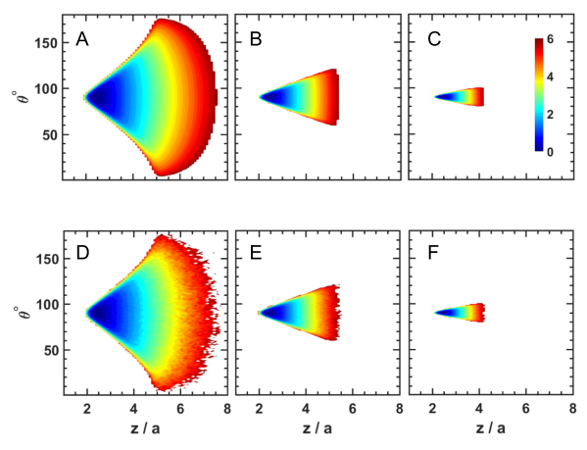
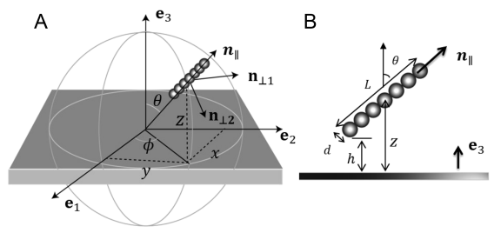
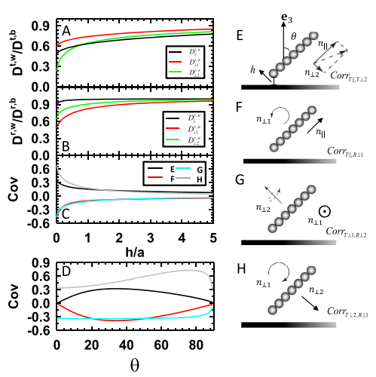
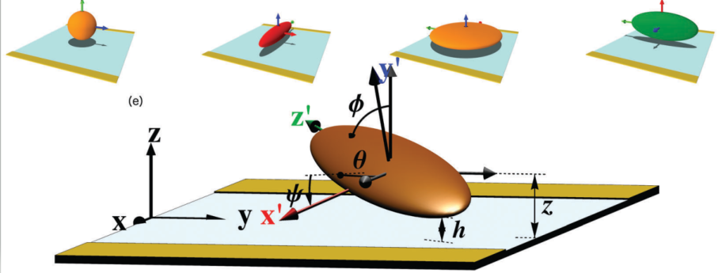
Dynamics of nonspherical particle dynamics

Slide 3
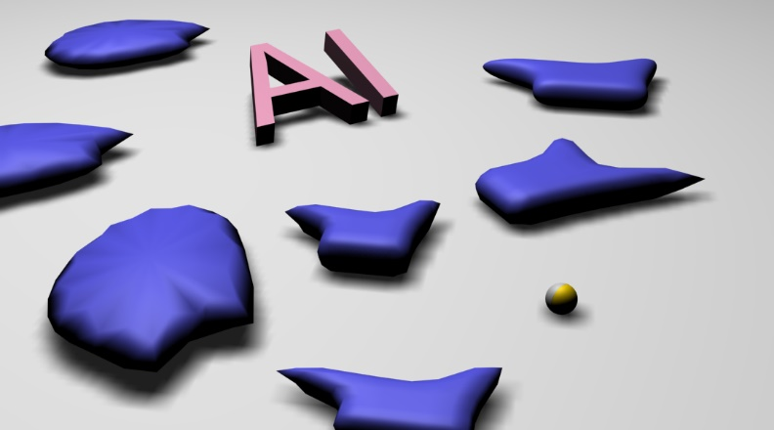
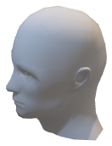

Slide 5
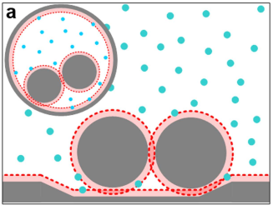
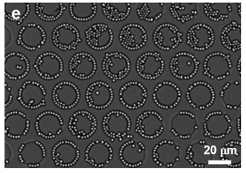
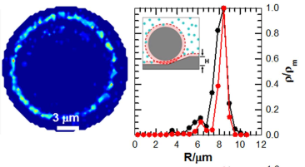
Geometry mediated colloidal particle assembly

Slide 6
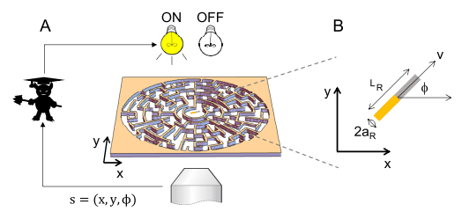
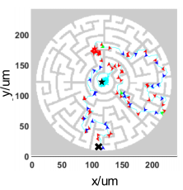
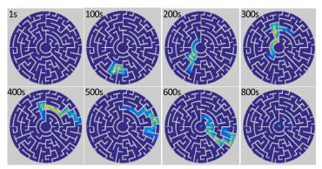
Maze navigation via model-based Markov decision process

Slide 7
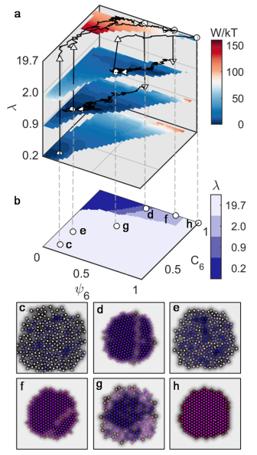
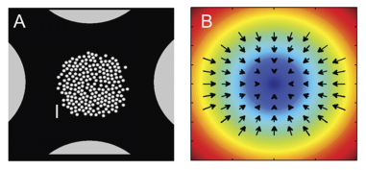
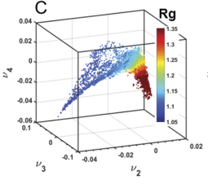
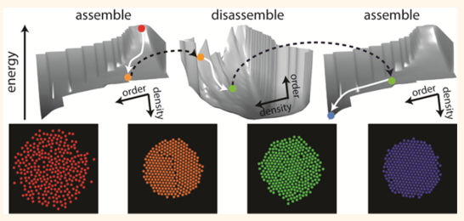
Manifold based optimal control of dynamic assembly processes
B

Slide 8
B

Slide 10
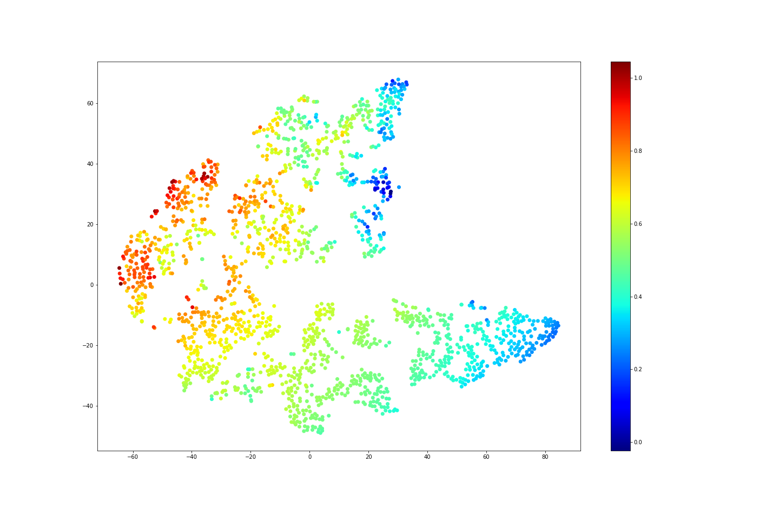
Efficient navigation in unknown complex environments
Target
Sensory input
Proxy target
(dx, dy)
Proxy target position
ON
OFF
(a)
(b)
Convolutional
Convolutional
Fully connected
1
3
5
2
6
4
V

Slide 11
(a)
(b)
1
3
5
2
6
4
V

Slide 12
Efficient navigation in unknown complex environments

Slide 13
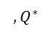
Efficient navigation in unknown complex environments
(dx, dy)
Proxy target position
Target
(dx, dy)
Sensory input
Proxy target
Proxy target position
$$,Q^{∗}$$
Convolutional
Convolutional
Fully connected

Slide 15
Robots are assigned to different targets before assembly begins
Seeding
Sequential assembly & growth
4
4
3
4
3
4
3
4
3
4
4
4
4
3
4
3
4
3
4
3
4
4
4
4
3
4
3
4
3
4
3
4
4
4
4
3
4
3
4
3
4
3
4
4
4
4
3
4
3
4
3
4
3
4
4
4
3
3
2
2
1
2
1
2
2
3
3
4
4
4
4
3
3
2
2
1
2
1
2
2
3
3
4
4
4
3
2
2
1
2
2
3
3
4
4
4
3
3
2
2
1
2
1
2
2
3
3
4
4
4
3
2
2
2
3
4
4
4
3
2
1
0
1
2
3
4
4
3
2
1
0
1
2
3
4
4
4
3
3
2
2
1
1
0
1
2
3
4
4
4
3
2
1
0
1
2
3
4
4
4
3
3
2
2
1
1
0
1
1
2
2
3
3
4
4
4
4
3
3
2
2
1
2
1
2
2
3
3
4
4
4
4
3
3
2
2
1
2
1
2
2
3
3
4
4
4
3
2
1
1
2
2
3
3
4
4
4
4
3
3
2
2
1
2
1
2
2
3
3
4
4
4
3
2
1
1
2
3
4
4
3
3
3
3
4
4
3
3
3
3
4
4
4
3
3
2
3
2
3
3
4
4
3
3
3
3
4
4
4
3
3
2
3
2
3
2
3
3
4
4
4
4
4
4
4
4
4
4
4
4
4
4
4
4
4
4
4
4
4
4
4
4
4
4
4
Idle robots need to move out of target sites to avoid blocking working robots
Working robots needs to circumvent small length-scale obstacles to get to its target
Large length-scale navigation

Slide 16
Every robot is occupying nearest target with the highest priority.
Every robot will stay on its position once arrive.
Unify language (python / c++ / matlab)
1
0
1
0

Slide 18
Particles are assigned to different targets before assembly begins
Seeding
Sequential assembly & growth
Idle particles need to move out of target sites to avoid blocking working particles
working particles needs to circumvent small length-scale obstacles to get to its target
Large length-scale navigation

Slide 20
In-place transformation
6
5
5
5
5
5
5
6
3
3
3
3
6
5
4
4
4
4
4
5
6
3
2
2
2
3
6
5
4
3
3
3
3
4
5
6
3
2
1
1
2
3
5
4
3
2
2
2
3
4
5
3
2
1
0
1
2
3
5
4
3
2
1
1
2
3
4
5
3
2
1
1
2
3
4
3
2
1
0
1
2
3
4
3
2
2
2
3
5
4
3
2
1
1
2
3
4
5
3
3
3
3
5
4
3
2
2
2
3
4
5
6
5
4
3
3
3
3
4
5
6
6
5
4
4
4
4
4
5
6
6
5
5
5
5
5
5
6

Slide 21
In-place transformation
4
4
4
4
4
4
3
3
3
3
4
4
3
2
2
2
3
4
4
3
2
1
1
2
3
4
4
3
2
1
0
1
2
3
4
4
3
2
1
1
2
3
4
4
3
2
2
2
3
4
4
3
3
3
3
4
4
4
4
4
4

Slide 22
In-place transformation
6
6
6
6
6
6
6
6
5
5
5
5
5
5
6
6
5
4
4
4
4
4
5
6
6
5
4
3
3
3
3
4
5
6
6
5
4
3
2
2
2
3
4
5
6
6
5
4
3
2
1
1
2
3
4
5
6
6
5
4
3
2
1
0
1
2
3
4
5
6
6
5
4
3
2
1
1
2
3
4
5
6
6
5
4
3
2
2
2
3
4
5
6
6
5
4
3
3
3
3
4
5
6
6
5
4
4
4
4
4
5
6
6
5
5
5
5
5
5
6
6
6
6
6
6
6
6

Slide 23
In-place transformation
0
0
0
0
0
0
0
0
1
1
1
1
1
1
0
5
5
5
0
1
2
2
2
2
2
1
0
6
5
5
5
6
0
1
2
3
3
3
3
2
1
0
6
5
4
4
4
4
4
5
6
0
1
2
3
4
4
4
3
2
1
0
6
5
4
3
3
3
3
4
5
6
0
1
2
3
4
5
5
4
3
2
1
0
5
4
3
2
2
2
3
4
5
0
1
2
3
4
5
6
5
4
3
2
1
0
5
4
3
2
1
1
2
3
4
5
0
1
2
3
4
5
5
4
3
2
1
0
4
3
2
1
0
1
2
3
4
0
1
2
3
4
4
4
3
2
1
0
5
4
3
2
1
1
2
3
4
5
0
1
2
3
3
3
3
2
1
0
5
4
3
2
2
2
3
4
5
0
1
2
2
2
2
2
1
0
6
5
4
3
3
3
3
4
5
6
0
1
1
1
1
1
1
0
6
5
4
4
4
4
4
5
6
0
0
0
0
0
0
0
6
5
5
5
5
5
5
6
6
5
5
5
5
5
5
6
6
5
5
5
5
5
5
6
6
5
4
4
4
4
4
5
6
6
5
4
4
4
4
4
5
6
6
5
4
3
3
3
3
4
5
6
6
5
4
3
3
3
3
4
5
6
6
5
5
5
5
5
5
6
5
4
3
2
2
2
3
4
5
5
4
3
2
2
2
3
4
5
6
5
4
4
4
4
4
5
6
5
4
3
2
1
1
2
3
4
5
5
4
3
2
1
1
2
3
4
5
6
5
4
3
3
3
3
4
5
6
4
3
2
1
0
1
2
3
4
4
3
2
1
0
1
2
3
4
5
4
3
2
2
2
3
4
5
5
4
3
2
1
1
2
3
4
5
5
4
3
2
1
1
2
3
4
5
5
4
3
2
1
1
2
3
4
5
5
4
3
2
2
2
3
4
5
5
4
3
2
2
2
3
4
5
4
3
2
1
0
1
2
3
4
6
5
4
3
3
3
3
4
5
6
6
5
4
3
3
3
3
4
5
6
5
4
3
2
1
1
2
3
4
5
6
5
4
4
4
4
4
5
6
6
5
4
4
4
4
4
5
6
5
4
3
2
2
2
3
4
5
6
5
5
5
5
5
5
6
6
5
5
5
5
5
5
6
6
5
4
3
3
3
3
4
5
6
6
5
4
4
4
4
4
5
6
6
5
5
5
5
5
5
6

Slide 24
In-place transformation
6
6
5
5
5
5
5
5
6
4
0
0
0
0
0
0
0
6
6
5
4
4
4
4
4
5
6
0
1
1
1
1
1
1
0
5
6
5
4
3
3
3
3
4
5
0
1
2
2
2
2
2
1
0
2
2
2
3
4
0
1
2
3
3
3
3
2
1
0
1
1
1
2
3
0
1
2
3
4
4
4
3
2
1
0
1
1
0
1
2
0
1
2
3
4
5
5
4
3
2
1
0
2
2
1
1
2
0
1
2
3
4
5
6
5
4
3
2
1
0
3
3
2
2
2
0
1
2
3
4
5
5
4
3
2
1
0
4
4
3
3
3
0
1
2
3
4
4
4
3
2
1
0
5
5
4
4
4
0
1
2
3
3
3
3
2
1
0
6
6
5
5
5
0
1
2
2
2
2
2
1
0
5
5
4
3
2
0
1
1
1
1
1
1
0
5
5
4
3
2
0
0
0
0
0
0
0
4
4
3
2
5
4
5
4
5
4
5
5
5
4
3
6
5
3
4
3
4
5
6
6
6
3
4
5
3
4
5
6
5
5

Slide 25



Slide 26


Slide 27
1
1
1
1
1
1
1
1
1
1
1
2
1
1
1
1
1
1
1
1
1
1
1
1
1
3
3
3
3
1
1
1
1
0
1
1
1
1
3
2
2
2
3
1
1
1
1
1
1
1
1
3
2
1
1
2
3
1
1
1
1
1
1
1
1
1
3
2
1
0
1
2
3
3
2
1
1
2
3
3
2
2
2
3
3
3
3
3

